Slide 1

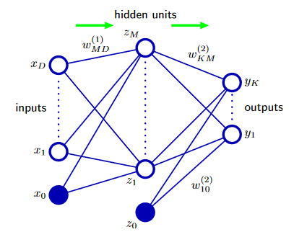


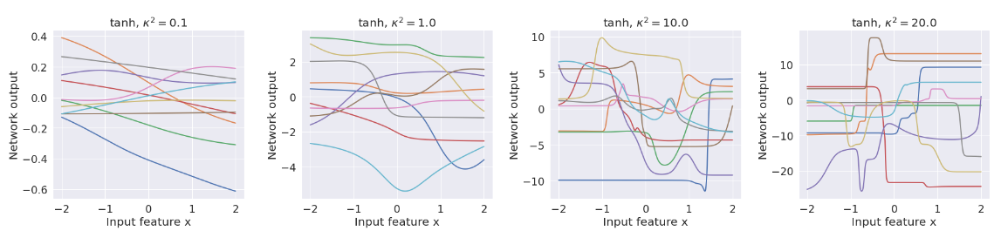
Challenges with neural networks
Hard:
Highly non-linear
Weight symmetries tanh(-a) = -tanh(a)
Non convex
Many parameters – mean field -> 2*m

Slide 2


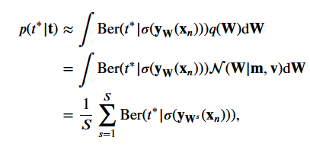
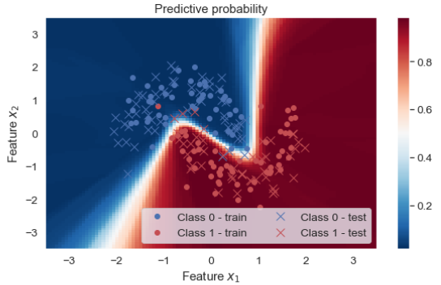
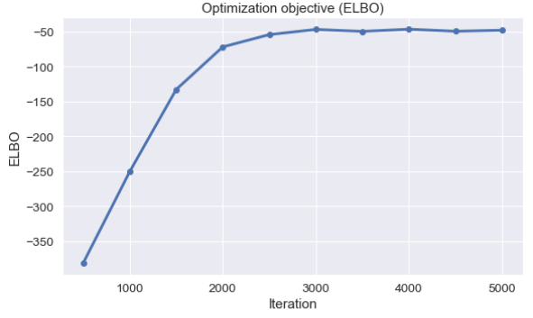

How to do inference
Fixed form
Like glm:
We need to solve:
We assume q is analytical available so we will investigate two methods for getting the gradients of p:
The score function estimator
The Pathwise gradient estimator

Slide 3
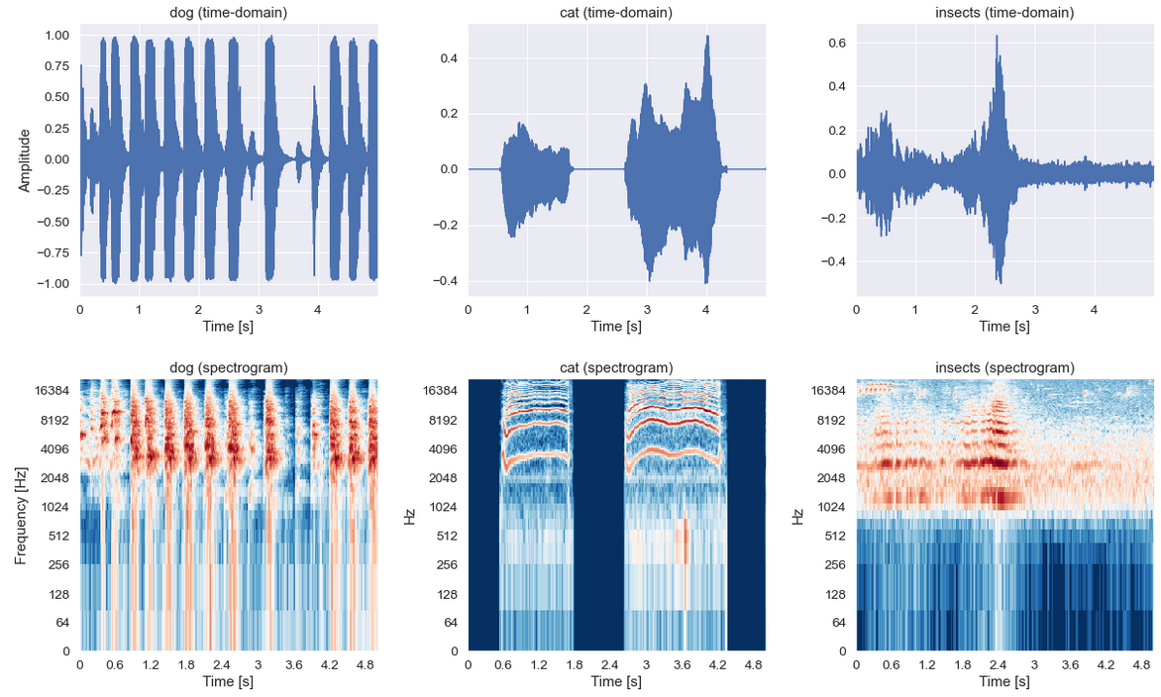
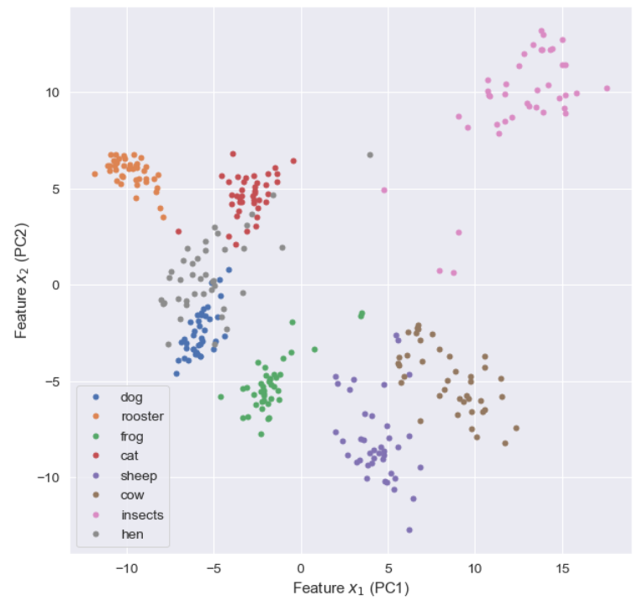
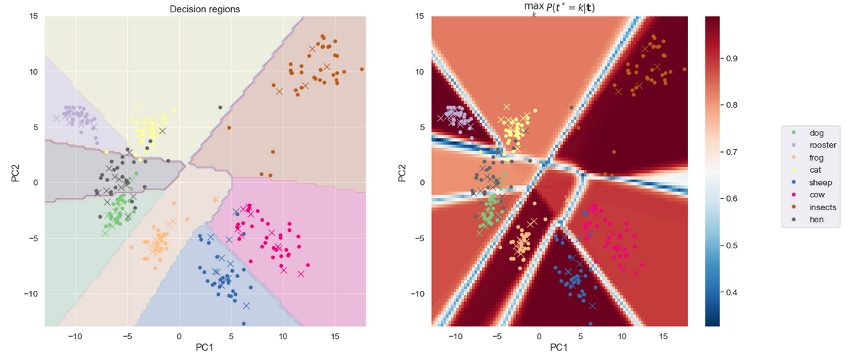
Application: Audio

